Slide 1
Neural Network
Neural networks (also known as artificial neural networks or neural nets, abbreviated ANN or NN) are a branch of machine learning models inspired by the neuronal organization found in the biological neural networks in animal brains

Slide 2
Neural Network
An ANN is made of connected units or nodes called artificial neurons, which loosely model the neurons in a brain. These are connected by edges, which model the synapses in a brain. An artificial neuron receives signals from connected neurons, then processes them and sends a signal to other connected neurons. The "signal" is a real number, and the output of each neuron is computed by some non-linear function of the sum of its inputs, called the activation function. Neurons and edges typically have a weight that adjusts as learning proceeds. The weight increases or decreases the strength of the signal at a connection.

Slide 3
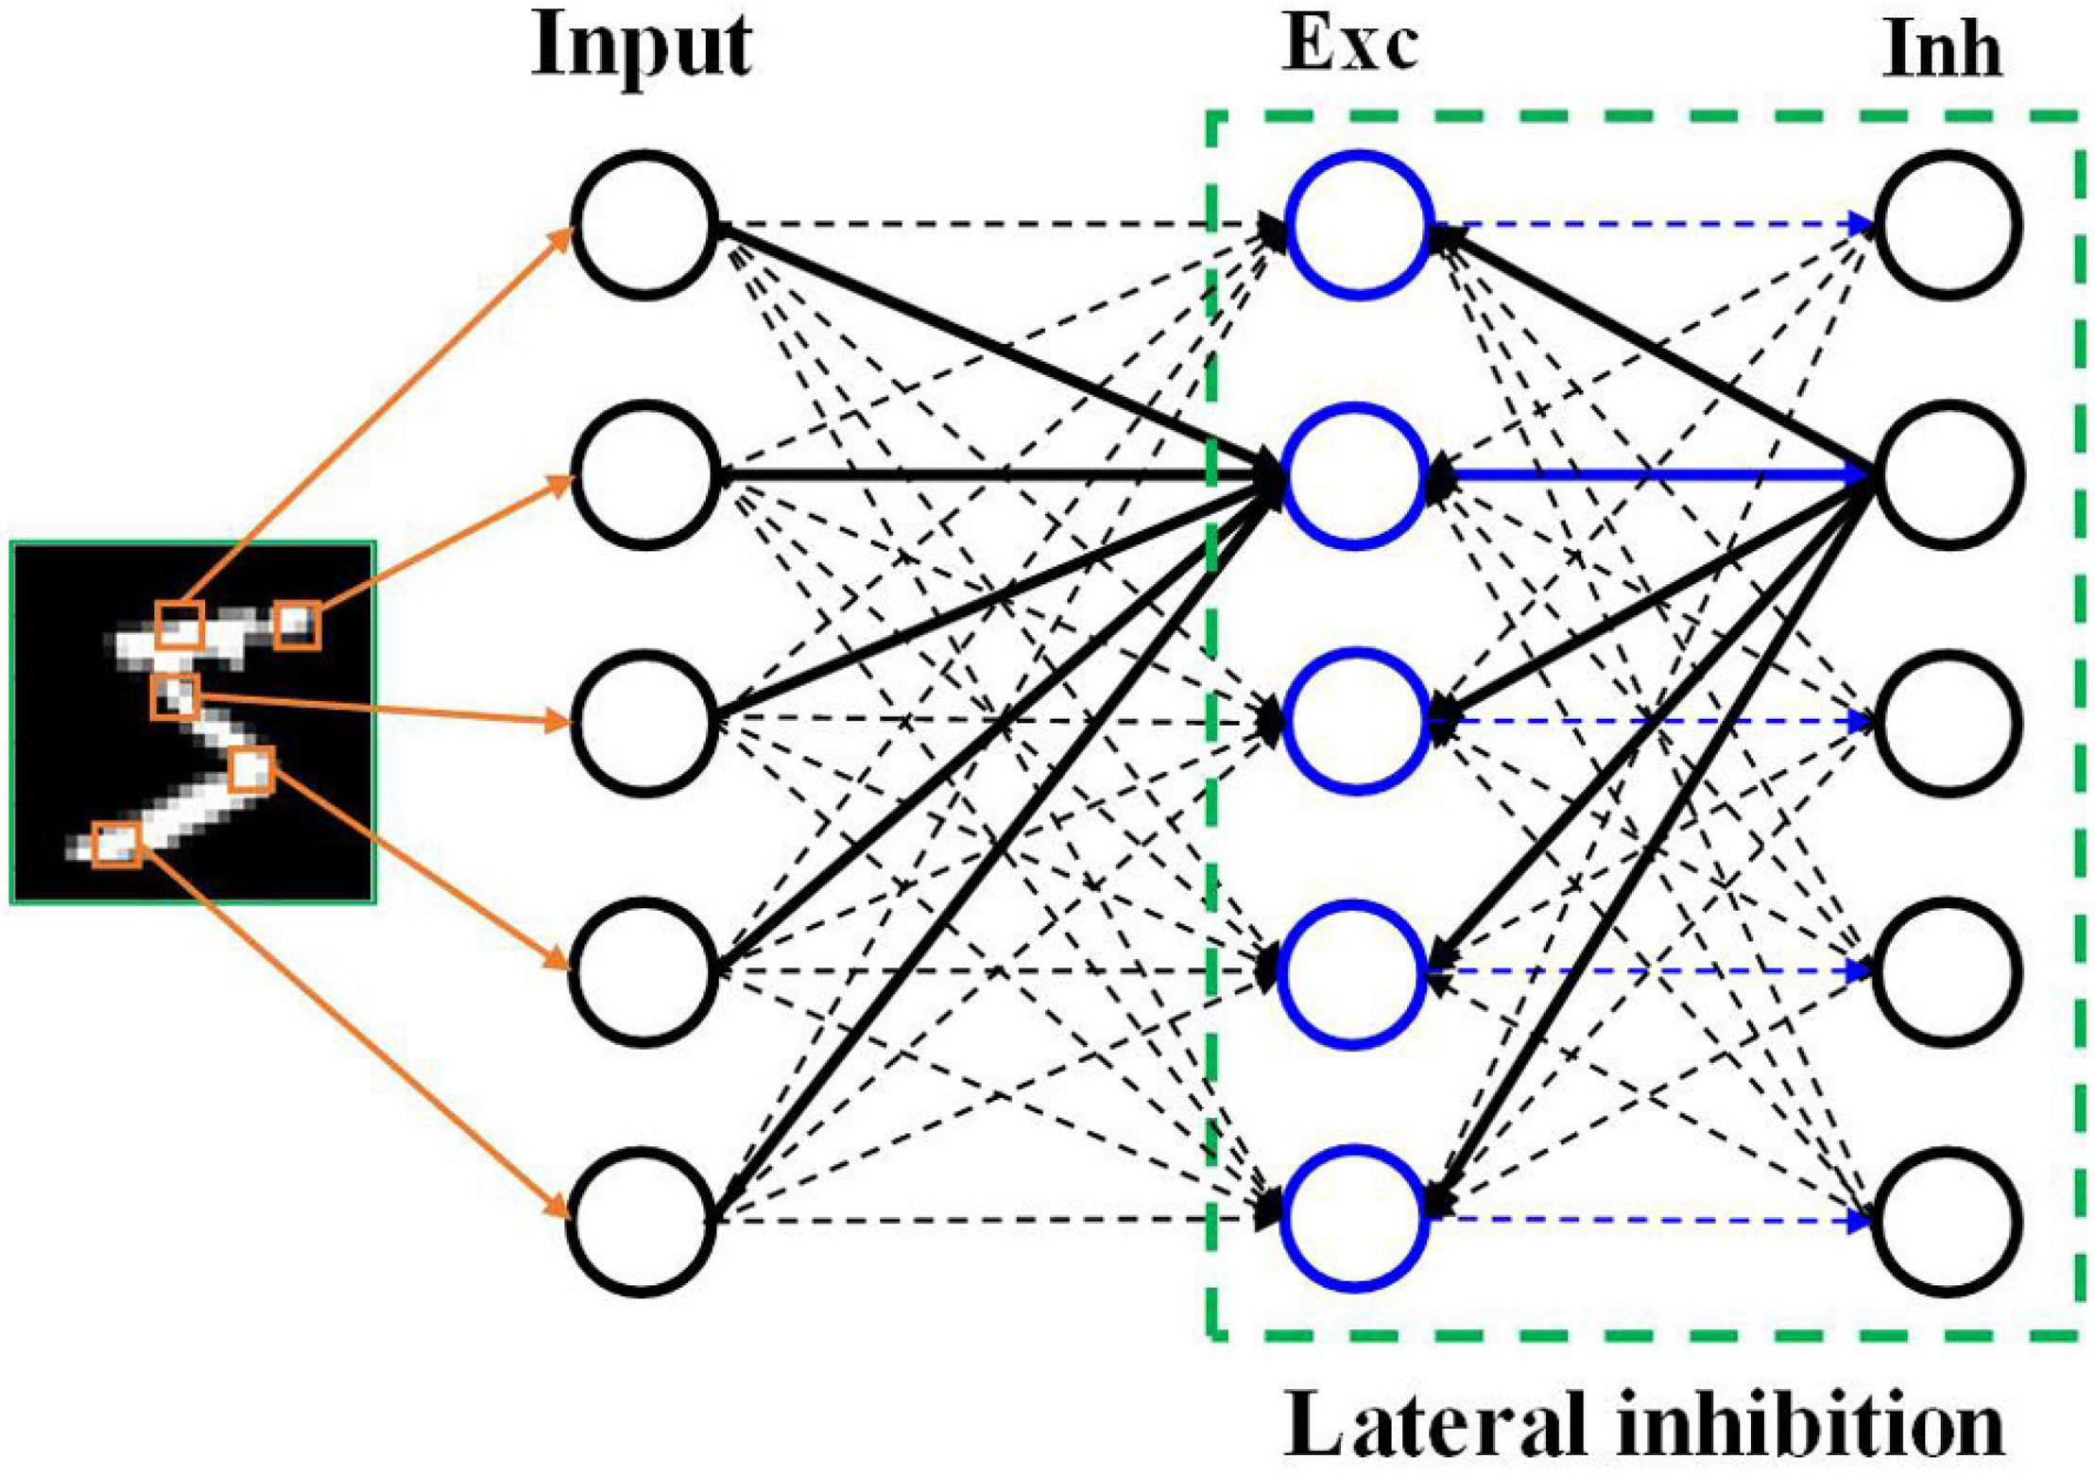
Neural Network

Slide 4
== Training ==
Neural networks are typically trained through empirical risk minimization. This method is based on the idea of optimizing the network's parameters to minimize the difference, or empirical risk, between the predicted output and the actual target values in a given dataset. Gradient based methods such as backpropagation are usually used to estimate the parameters of the network. During the training phase, ANNs learn from labeled training data by iteratively updating their parameters to minimize a defined loss function. This method allows the network to generalize to unseen data.

Slide 5
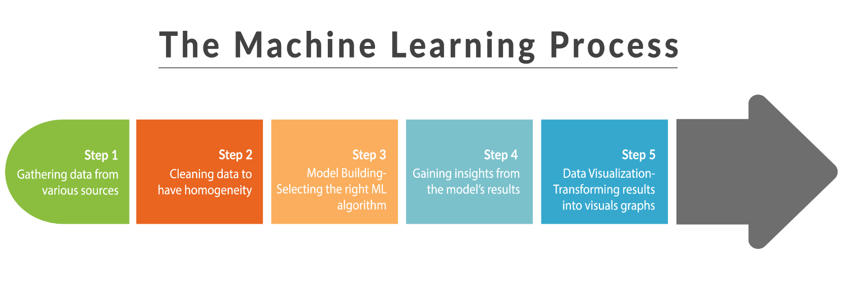
Training

Slide 6
== History ==
Historically, digital computers evolved from the von Neumann model, and operate via the execution of explicit instructions via access to memory by a number of processors. Neural networks, on the other hand, originated from efforts to model information processing in biological systems through the framework of connectionism. Unlike the von Neumann model, connectionist computing does not separate memory and processing.
The simplest kind of feedforward neural network (FNN) is a linear network, which consists of a single layer of output nodes; the inputs are fed directly to the outputs via a series of weights. The sum of the products of the weights and the inputs is calculated at each node. The mean squared errors between these calculated outputs and the given target values are minimized by creating an adjustment to the weights. This technique has been known for over two centuries as the method of least squares or linear regression. It was used as a means of finding a good rough linear fit to a set of points by Legendre (1805) and Gauss (1795) for the prediction of planetary movement.Wilhelm Lenz and Ernst Ising created and analyzed the Ising model (1925) which is essentially a non-learning artificial recurrent neural network (RNN) consisting of neuron-like threshold elements. In 1972, Shun'ichi Amari described an adaptive version of this architecture,
which was popularised by John Hopfield in 1982
and is now called a Hopfield network.
Warren McCulloch and Walter Pitts (1943) also considered a non-learning computational model for neural networks.In the late 1940s, D. O. Hebb created a learning hypothesis based on the mechanism of neural plasticity that became known as Hebbian learning. Hebbian learning is considered to be a 'typical' unsupervised learning rule and its later variants were early models for long term potentiation. These ideas started being applied to computational models in 1948 with Turing's "unorganized machines". Farley and Wesley A. Clark were the first to simulate a Hebbian network in 1954 at MIT. They used computational machines, then called "calculators". Other neural network computational machines were created by Rochester, Holland, Habit, and Duda in 1956. In 1958, psychologist Frank Rosenblatt invented the perceptron, the first implemented artificial neural network, funded by the United States Office of Naval Research.

Slide 7
== History ==
The invention of the perceptron raised public excitement for research in Artificial Neural Networks, causing the US government to drastically increase funding into deep learning research. This led to "the golden age of AI" fueled by the optimistic claims made by computer scientists regarding the ability of perceptrons to emulate human intelligence. For example, in 1957 Herbert Simon famously said:It is not my aim to surprise or shock you—but the simplest way I can summarize is to say that there are now in the world machines that think, that learn and that create. Moreover, their ability to do these things is going to increase rapidly until—in a visible future—the range of problems they can handle will be coextensive with the range to which the human mind has been applied.However, this wasn't the case as research stagnated in the United States following the work of Minsky and Papert (1969), who discovered that basic perceptrons were incapable of processing the exclusive-or circuit and that computers lacked sufficient power to train useful neural networks. This, along with other factors such as the 1973 Lighthill report by James Lighthill stating that research in Artificial Intelligence has not "produced the major impact that was then promised," shutting funding in research into the field of AI in all but two universities in the UK and in many major institutions across the world. This ushered an era called the AI Winter with reduced research into connectionism due to a decrease in government funding and an increased stress on symbolic artificial intelligence in the United States and other Western countries.During the AI Winter era, however, research outside the United States continued, especially in Eastern Europe. By the time Minsky and Papert's book on Perceptrons came out, methods for training multilayer perceptrons (MLPs) were already known. The first deep learning Multi Layer Perceptron (MLP) was published by Alexey Grigorevich Ivakhnenko and Valentin Lapa in 1965, as the Group Method of Data Handling. The first deep learning MLP trained by stochastic gradient descent was published in 1967 by Shun'ichi Amari. In computer experiments conducted by Amari's student Saito, a five layer MLP with two modifiable layers learned useful internal representations to classify non-linearily separable pattern classes.Self-organizing maps (SOMs) were described by Teuvo Kohonen in 1982. SOMs are neurophysiologically inspired neural networks that learn low-dimensional representations of high-dimensional data while preserving the topological structure of the data. They are trained using competitive learning.The convolutional neural network (CNN) architecture with convolutional layers and downsampling layers was introduced by Kunihiko Fukushima in 1980. He called it the neocognitron. In 1969, he also introduced the ReLU (rectified linear unit) activation function. The rectifier has become the most popular activation function for CNNs and deep neural networks in general. CNNs have become an essential tool for computer vision.

Slide 8
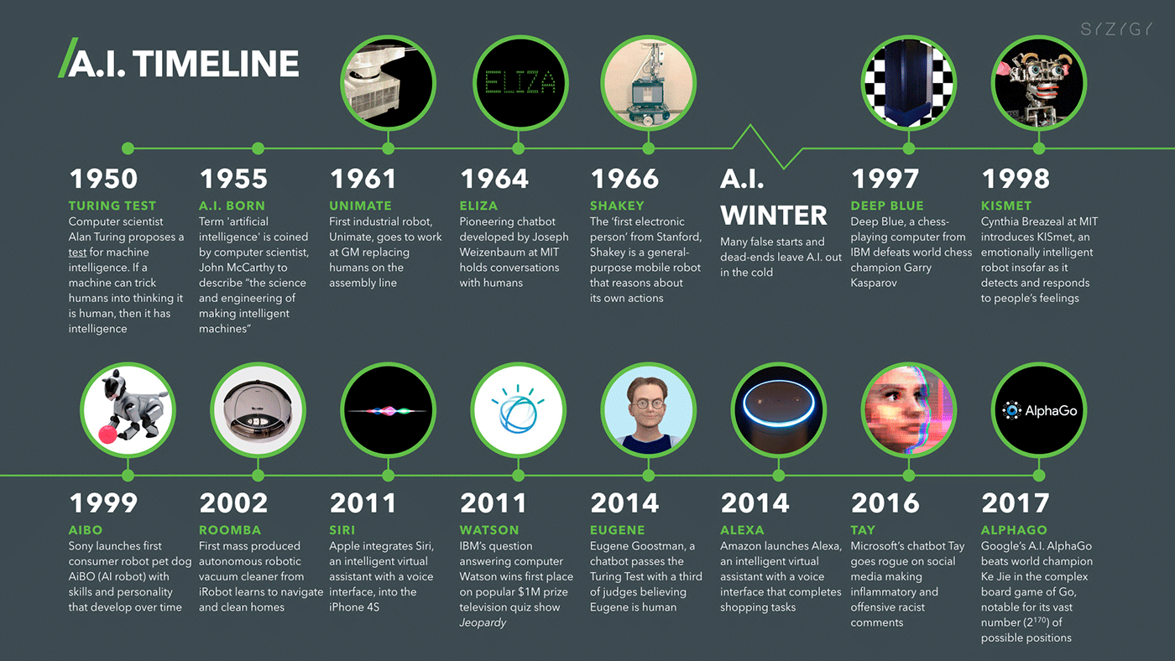
History

Slide 9
== Models ==
ANNs began as an attempt to exploit the architecture of the human brain to perform tasks that conventional algorithms had little success with. They soon reoriented towards improving empirical results, abandoning attempts to remain true to their biological precursors. ANNs have the ability to learn and model non-linearities and complex relationships. This is achieved by neurons being connected in various patterns, allowing the output of some neurons to become the input of others. The network forms a directed, weighted graph.An artificial neural network consists of simulated neurons. Each neuron is connected to other nodes via links like a biological axon-synapse-dendrite connection. All the nodes connected by links take in some data and use it to perform specific operations and tasks on the data. Each link has a weight, determining the strength of one node's influence on another, allowing weights to choose the signal between neurons.

Slide 10
=== Artificial neurons ===
ANNs are composed of artificial neurons which are conceptually derived from biological neurons. Each artificial neuron has inputs and produces a single output which can be sent to multiple other neurons. The inputs can be the feature values of a sample of external data, such as images or documents, or they can be the outputs of other neurons. The outputs of the final output neurons of the neural net accomplish the task, such as recognizing an object in an image.
To find the output of the neuron we take the weighted sum of all the inputs, weighted by the weights of the connections from the inputs to the neuron. We add a bias term to this sum. This weighted sum is sometimes called the activation. This weighted sum is then passed through a (usually nonlinear) activation function to produce the output. The initial inputs are external data, such as images and documents. The ultimate outputs accomplish the task, such as recognizing an object in an image.

Slide 11
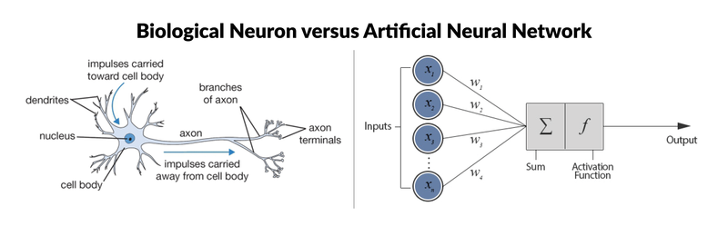
Artificial neurons

Slide 12
=== Organization ===
The neurons are typically organized into multiple layers, especially in deep learning. Neurons of one layer connect only to neurons of the immediately preceding and immediately following layers. The layer that receives external data is the input layer. The layer that produces the ultimate result is the output layer. In between them are zero or more hidden layers. Single layer and unlayered networks are also used. Between two layers, multiple connection patterns are possible. They can be 'fully connected', with every neuron in one layer connecting to every neuron in the next layer. They can be pooling, where a group of neurons in one layer connects to a single neuron in the next layer, thereby reducing the number of neurons in that layer. Neurons with only such connections form a directed acyclic graph and are known as feedforward networks. Alternatively, networks that allow connections between neurons in the same or previous layers are known as recurrent networks.

Slide 13
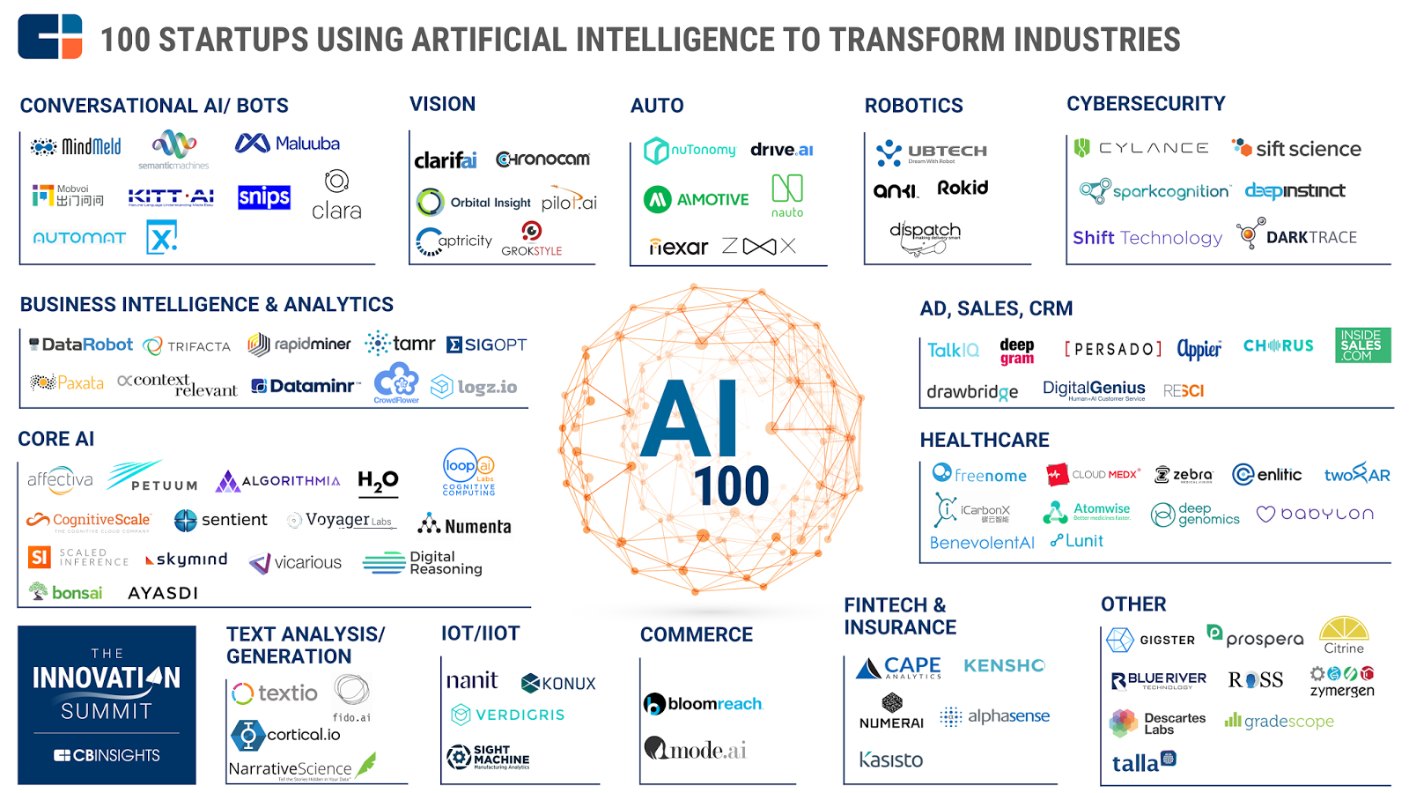
Organization

Slide 14
=== Hyperparameter ===
A hyperparameter is a constant parameter whose value is set before the learning process begins. The values of parameters are derived via learning. Examples of hyperparameters include learning rate, the number of hidden layers and batch size. The values of some hyperparameters can be dependent on those of other hyperparameters. For example, the size of some layers can depend on the overall number of layers.

Slide 15
=== Learning ===
Learning is the adaptation of the network to better handle a task by considering sample observations. Learning involves adjusting the weights (and optional thresholds) of the network to improve the accuracy of the result. This is done by minimizing the observed errors. Learning is complete when examining additional observations does not usefully reduce the error rate. Even after learning, the error rate typically does not reach 0. If after learning, the error rate is too high, the network typically must be redesigned. Practically this is done by defining a cost function that is evaluated periodically during learning. As long as its output continues to decline, learning continues. The cost is frequently defined as a statistic whose value can only be approximated. The outputs are actually numbers, so when the error is low, the difference between the output (almost certainly a cat) and the correct answer (cat) is small. Learning attempts to reduce the total of the differences across the observations. Most learning models can be viewed as a straightforward application of optimization theory and statistical estimation.

Slide 16
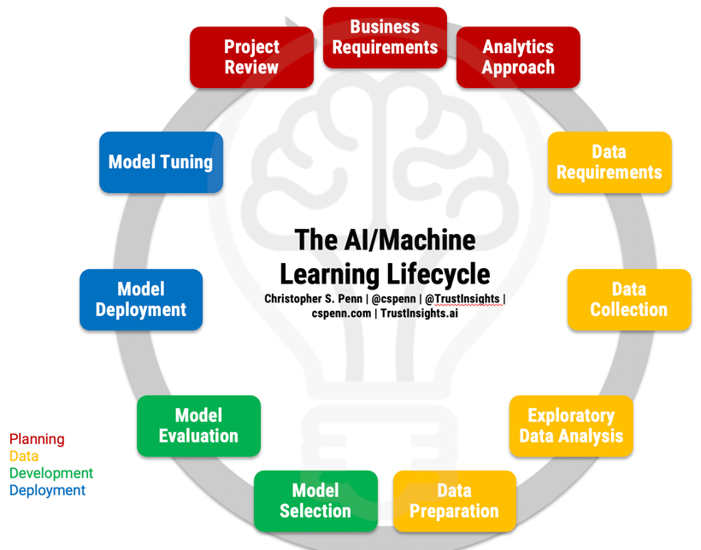
Learning

Slide 17
==== Cost function ====
function's desirable properties (such as convexity) or because it arises from the model (e.g. in a probabilistic model the model's posterior probability can be used as an inverse cost).

Slide 18
=== Learning paradigms ===
Machine learning is commonly separated into three main learning paradigms, supervised learning, unsupervised learning and reinforcement learning. Each corresponds to a particular learning task.

Slide 19
==== Self-learning ====
Self-learning in neural networks was introduced in 1982 along with a neural network capable of self-learning named crossbar adaptive array (CAA). It is a system with only one input, situation s, and only one output, action (or behavior) a. It has neither external advice input nor external reinforcement input from the environment. The CAA computes, in a crossbar fashion, both decisions about actions and emotions (feelings) about encountered situations. The system is driven by the interaction between cognition and emotion. Given the memory matrix, W =||w(a,s)||, the crossbar self-learning algorithm in each iteration performs the following computation:
In situation s perform action a;
Receive consequence situation s';
Compute emotion of being in consequence situation v(s');
Update crossbar memory w'(a,s) = w(a,s) + v(s').
The backpropagated value (secondary reinforcement) is the emotion toward the consequence situation. The CAA exists in two environments, one is behavioral environment where it behaves, and the other is genetic environment, where from it initially and only once receives initial emotions about to be encountered situations in the behavioral environment. Having received the genome vector (species vector) from the genetic environment, the CAA will learn a goal-seeking behavior, in the behavioral environment that contains both desirable and undesirable situations.

Slide 20
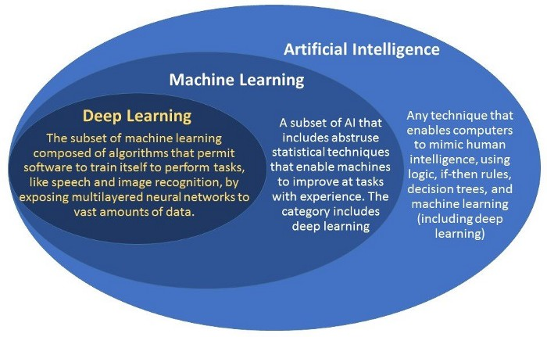
Self-learning

Slide 21
=== Stochastic neural network ===
Stochastic neural networks originating from Sherrington–Kirkpatrick models are a type of artificial neural network built by introducing random variations into the network, either by giving the network's artificial neurons stochastic transfer functions, or by giving them stochastic weights. This makes them useful tools for optimization problems, since the random fluctuations help the network escape from local minima. Stochastic neural networks trained using a Bayesian approach are known as Bayesian neural networks.

Slide 22
=== Other ===
In a Bayesian framework, a distribution over the set of allowed models is chosen to minimize the cost. Evolutionary methods, gene expression programming, simulated annealing, expectation-maximization, non-parametric methods and particle swarm optimization are other learning algorithms. Convergent recursion is a learning algorithm for cerebellar model articulation controller (CMAC) neural networks.

Slide 23
==== Modes ====
Two modes of learning are available: stochastic and batch. In stochastic learning, each input creates a weight adjustment. In batch learning weights are adjusted based on a batch of inputs, accumulating errors over the batch. Stochastic learning introduces "noise" into the process, using the local gradient calculated from one data point; this reduces the chance of the network getting stuck in local minima. However, batch learning typically yields a faster, more stable descent to a local minimum, since each update is performed in the direction of the batch's average error. A common compromise is to use "mini-batches", small batches with samples in each batch selected stochastically from the entire data set.

Slide 24
== Types ==
ANNs have evolved into a broad family of techniques that have advanced the state of the art across multiple domains. The simplest types have one or more static components, including number of units, number of layers, unit weights and topology. Dynamic types allow one or more of these to evolve via learning. The latter is much more complicated but can shorten learning periods and produce better results. Some types allow/require learning to be "supervised" by the operator, while others operate independently. Some types operate purely in hardware, while others are purely software and run on general purpose computers.
Some of the main breakthroughs include:
Convolutional neural networks that have proven particularly successful in processing visual and other two-dimensional data; where long short-term memory avoids the vanishing gradient problem and can handle signals that have a mix of low and high frequency components aiding large-vocabulary speech recognition, text-to-speech synthesis, and photo-real talking heads;
Competitive networks such as generative adversarial networks in which multiple networks (of varying structure) compete with each other, on tasks such as winning a game or on deceiving the opponent about the authenticity of an input.

Slide 25
== Network design ==
Using artificial neural networks requires an understanding of their characteristics.
Choice of model: This depends on the data representation and the application. Model parameters include the number, type, and connectedness of network layers, as well as the size of each and the connection type (full, pooling, etc. ). Overly complex models learn slowly.
Learning algorithm: Numerous trade-offs exist between learning algorithms. Almost any algorithm will work well with the correct hyperparameters for training on a particular data set. However, selecting and tuning an algorithm for training on unseen data requires significant experimentation.
Robustness: If the model, cost function and learning algorithm are selected appropriately, the resulting ANN can become robust.Neural architecture search (NAS) uses machine learning to automate ANN design. Various approaches to NAS have designed networks that compare well with hand-designed systems. The basic search algorithm is to propose a candidate model, evaluate it against a dataset, and use the results as feedback to teach the NAS network. Available systems include AutoML and AutoKeras. scikit-learn library provides functions to help with building a deep network from scratch. We can then implement a deep network with TensorFlow or Keras.
Hyperparameters must also be defined as part of the design (they are not learned), governing matters such as how many neurons are in each layer, learning rate, step, stride, depth, receptive field and padding (for CNNs), etc. The Python code snippet provides an overview of the training function, which uses the training dataset, number of hidden layer units, learning rate, and number of iterations as parameters:

Slide 26
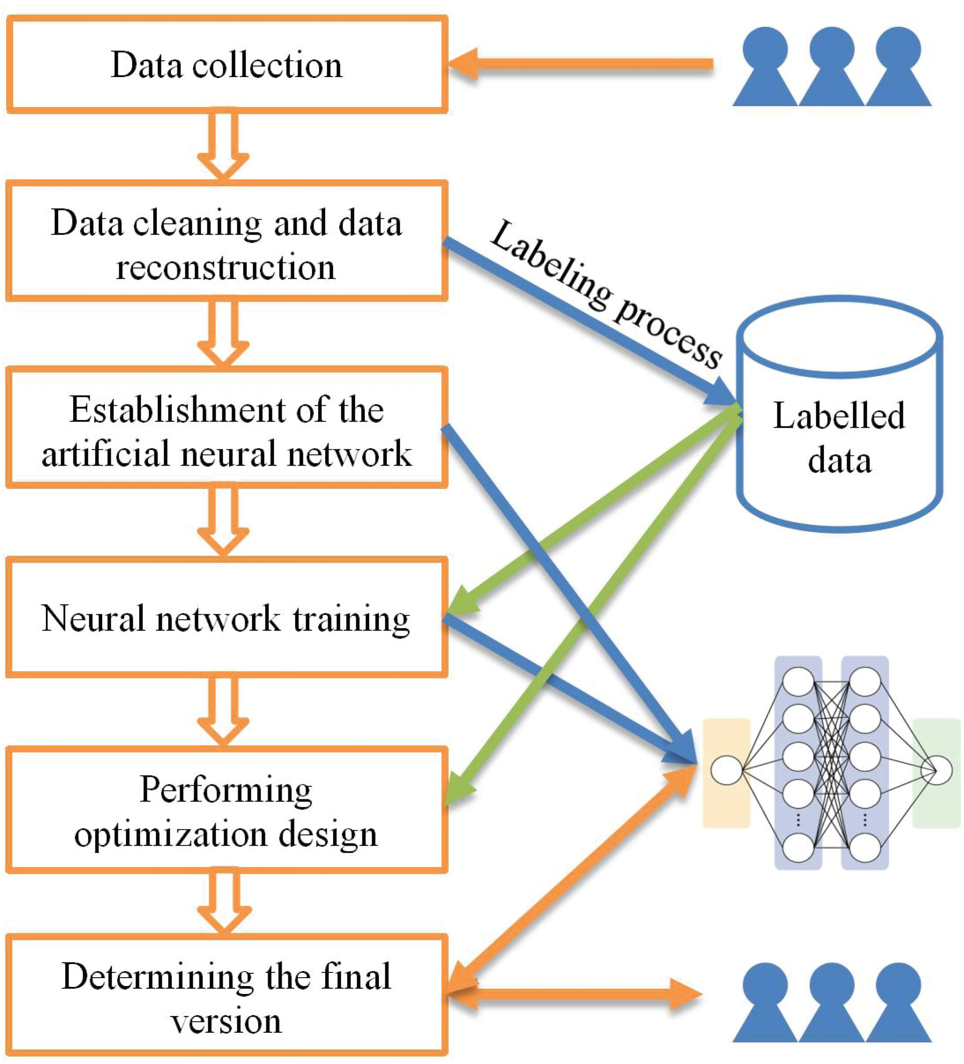
Network design

Slide 27
=== Computational power ===
The multilayer perceptron is a universal function approximator, as proven by the universal approximation theorem. However, the proof is not constructive regarding the number of neurons required, the network topology, the weights and the learning parameters.
A specific recurrent architecture with rational-valued weights (as opposed to full precision real number-valued weights) has the power of a universal Turing machine, using a finite number of neurons and standard linear connections. Further, the use of irrational values for weights results in a machine with super-Turing power.

Slide 28
=== Capacity ===
A model's "capacity" property corresponds to its ability to model any given function. It is related to the amount of information that can be stored in the network and to the notion of complexity.
Two notions of capacity are known by the community. The information capacity and the VC Dimension. The information capacity of a perceptron is intensively discussed in Sir David MacKay's book which summarizes work by Thomas Cover. The capacity of a network of standard neurons (not convolutional) can be derived by four rules that derive from understanding a neuron as an electrical element. The information capacity captures the functions modelable by the network given any data as input. The second notion, is the VC dimension. VC Dimension uses the principles of measure theory and finds the maximum capacity under the best possible circumstances. This is, given input data in a specific form. As noted in, the VC Dimension for arbitrary inputs is half the information capacity of a Perceptron. The VC Dimension for arbitrary points is sometimes referred to as Memory Capacity.

Slide 29
=== Convergence ===
Models may not consistently converge on a single solution, firstly because local minima may exist, depending on the cost function and the model. Secondly, the optimization method used might not guarantee to converge when it begins far from any local minimum. Thirdly, for sufficiently large data or parameters, some methods become impractical.
Another issue worthy to mention is that training may cross some Saddle point which may lead the convergence to the wrong direction.
The convergence behavior of certain types of ANN architectures are more understood than others. When the width of network approaches to infinity, the ANN is well described by its first order Taylor expansion throughout training, and so inherits the convergence behavior of affine models. Another example is when parameters are small, it is observed that ANNs often fits target functions from low to high frequencies. This behavior is referred to as the spectral bias, or frequency principle, of neural networks. This phenomenon is the opposite to the behavior of some well studied iterative numerical schemes such as Jacobi method. Deeper neural networks have been observed to be more biased towards low frequency functions.

Slide 30
=== Generalization and statistics ===
Applications whose goal is to create a system that generalizes well to unseen examples, face the possibility of over-training. This arises in convoluted or over-specified systems when the network capacity significantly exceeds the needed free parameters. Two approaches address over-training. The first is to use cross-validation and similar techniques to check for the presence of over-training and to select hyperparameters to minimize the generalization error.
The second is to use some form of regularization. This concept emerges in a probabilistic (Bayesian) framework, where regularization can be performed by selecting a larger prior probability over simpler models; but also in statistical learning theory, where the goal is to minimize over two quantities: the 'empirical risk' and the 'structural risk', which roughly corresponds to the error over the training set and the predicted error in unseen data due to overfitting.

Slide 31
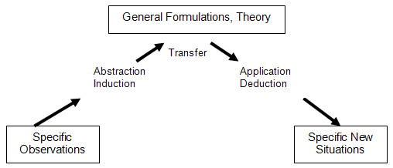
Generalization and statistics

Slide 32
=== Theory ===
A central claim of ANNs is that they embody new and powerful general principles for processing information. These principles are ill-defined. It is often claimed that they are emergent from the network itself. This allows simple statistical association (the basic function of artificial neural networks) to be described as learning or recognition. In 1997, Alexander Dewdney, a former Scientific American columnist, commented that as a result, artificial neural networks have a "something-for-nothing quality, one that imparts a peculiar aura of laziness and a distinct lack of curiosity about just how good these computing systems are. No human hand (or mind) intervenes; solutions are found as if by magic; and no one, it seems, has learned anything". One response to Dewdney is that neural networks have been successfully used to handle many complex and diverse tasks, ranging from autonomously flying aircraft to detecting credit card fraud to mastering the game of Go.
Technology writer Roger Bridgman commented:
Neural networks, for instance, are in the dock not only because they have been hyped to high heaven, (what hasn't?) but also because you could create a successful net without understanding how it worked: the bunch of numbers that captures its behaviour would in all probability be "an opaque, unreadable table...valueless as a scientific resource".

Slide 33
=== Dataset bias ===
Neural networks are dependent on the quality of the data they are trained on, thus low quality data with imbalanced representativeness can lead to the model learning and perpetuating societal biases. These inherited biases become especially critical when the ANNs are integrated into real-world scenarios where the training data may be imbalanced due to the scarcity of data for a specific race, gender or other attribute. This imbalance can result in the model having inadequate representation and understanding of underrepresented groups, leading to discriminatory outcomes that exasperate societal inequalities, especially in applications like facial recognition, hiring processes, and law enforcement. For example, in 2018, Amazon had to scrap a recruiting tool because the model favored men over women for jobs in software engineering due to the higher number of male workers in the field. The program would penalize any resume with the word "woman" or the name of any women's college. However, the use of synthetic data can help reduce dataset bias and increase representation in datasets.

Slide 34
=== Image processing ===
In the realm of image processing, ANNs are employed in tasks such as image classification, object recognition, and image segmentation. For instance, deep convolutional neural networks (CNNs) have been important in handwritten digit recognition, achieving state-of-the-art performance. This demonstrates the ability of ANNs to effectively process and interpret complex visual information, leading to advancements in fields ranging from automated surveillance to medical imaging.

Slide 35
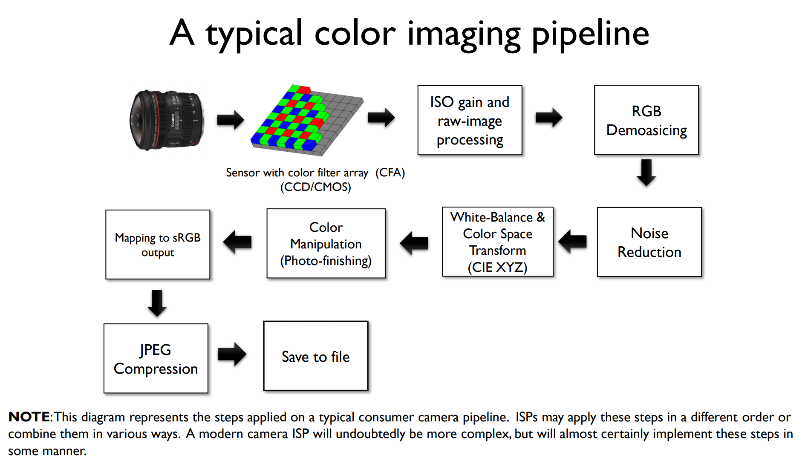
Image processing

